Slide 1
Air Quality in Delhi
By: Devanshu Mehrotra

Slide 2
The Motivation
“Nearly 12.5 percent of total deaths recorded in India for the year of 2017 can be attributed to the toxic air quality”
- Global Burden of Disease Study
New Delhi was recently ranked and the most polluted city in the world with a maximum Air Quality Index (AQI) of 527.
To put that into context, an AQI between 301-500 is considered so hazardous that the EPA suggests that the populace be given “Health warnings of emergency conditions”
1.24 million people lost their lives due to pollution in 2017 alone.
Being a former resident of India and as someone whose immediate close family members still live in Delhi, this project takes on a personal meaning to me.

Slide 3
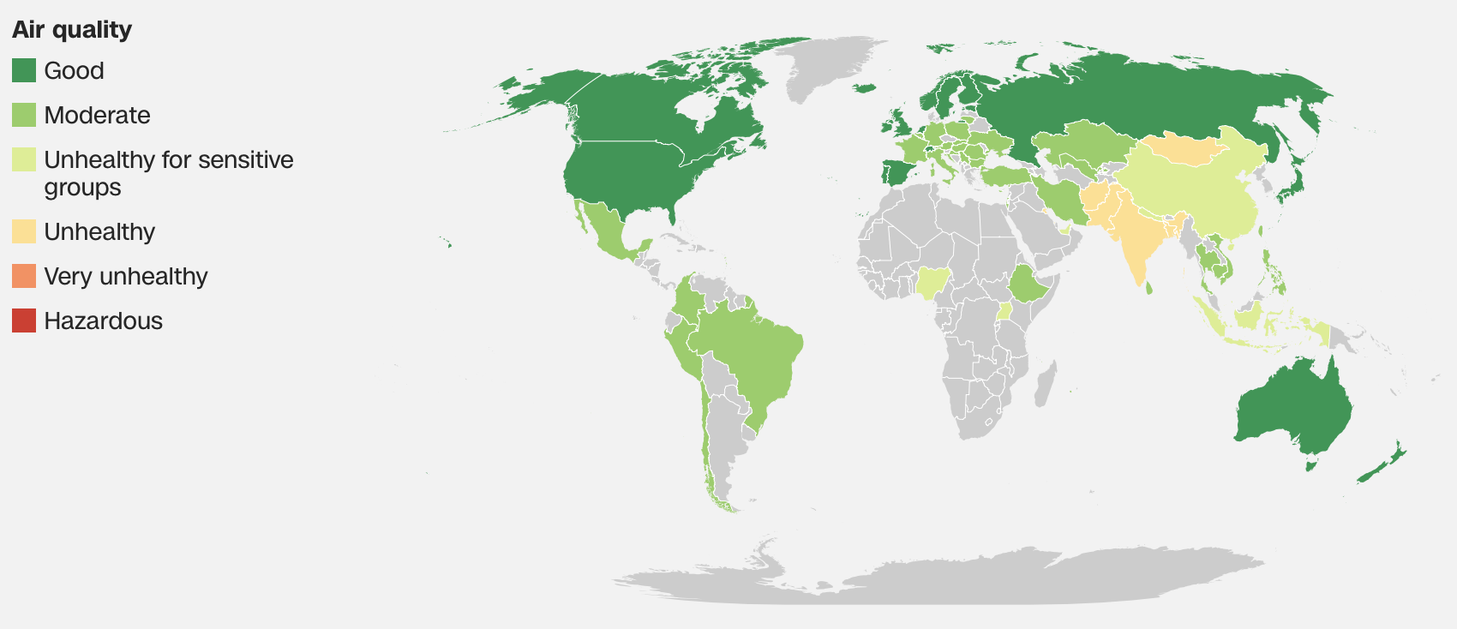
The Motivation
"In the wake of rising level of pollution caused by stubble burning, the Delhi government has decided to shut all schools till November 5” - Translated tweet by Delhi Chief Minister Arvind Kejriwal (dated 11/1/2019)
This is not a new phenomenon. Even back in 2015 Delhi was ranked the most polluted city in the world with an average AQI of 153.
In fact in a study by CNN 22 of the top 30 most polluted cities in the world were in India
This should bring into question environmental regulations in place and governmental enforcement actions

Slide 4
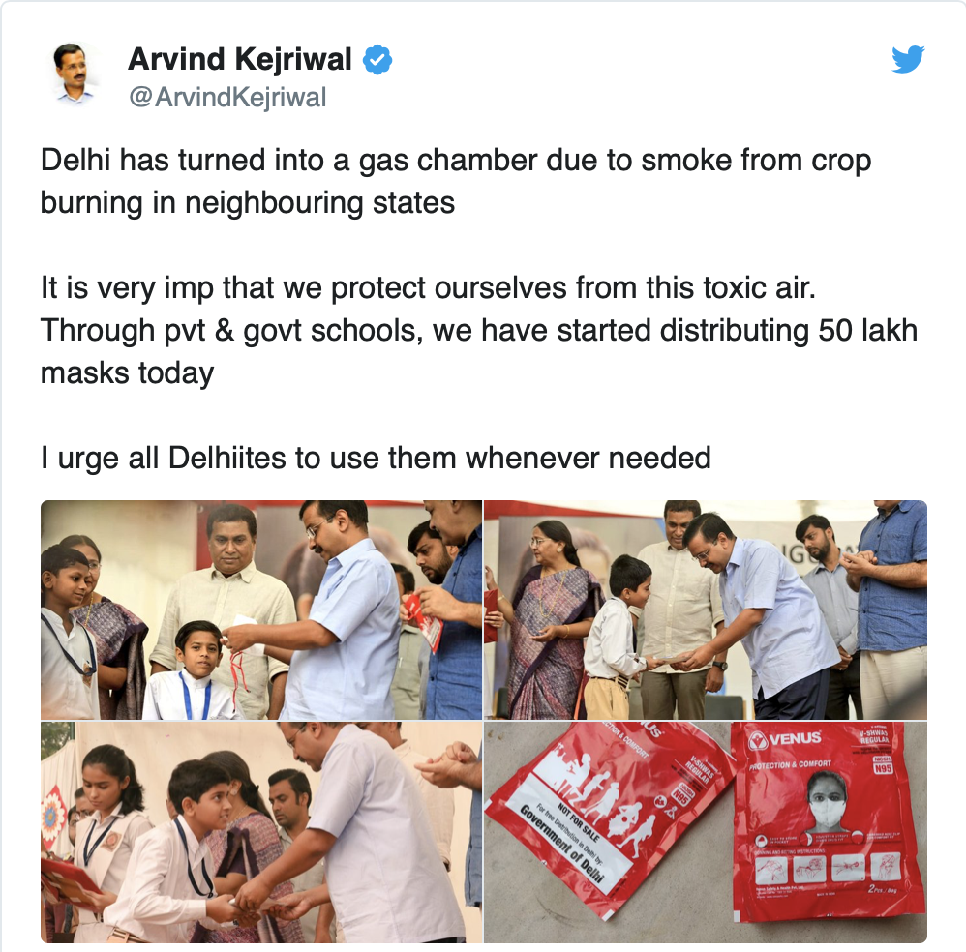
The Motivation
”Delhi has turned into a gas chamber…” - tweet by Delhi Chief Minister Arvind Kejriwal
Many dubious claims have been put forth by the government to explain away the atrocious air quality in Delhi. In this project my goal was to use data and try and test these claims similar to how I would test a hypothesis.
Claim 1: The pollution might be bad but it has been on a downward trend and things are getting better.
Claim 2: Increase in the breathable particulate matter is a direct result of “stubble burning” by farmers in the neighboring state of Punjab.
Claim 3: Pollution has been bad because of prevailing wind conditions.

Slide 5
The Workflow
In order to be as effective and efficient as possible the OSEMN data science workflow was adhered to and the claims above were tested in the following manner:
Claim 1: obtain air quality data and compare the trends year over year
Claim 2: review the annual harvest yields for a winter crop such as what and see if the yields seem to have a correlation with the pollution.
Claim 3: source weather data and compare these against the pollution numbers to determine if there is a correlation.

Slide 6
The Data
Pollution Data
The US Embassy in New Delhi records daily level of various common pollutants and makes them publicly available here.
For the purposes of this project we focused on two indicators of pollution namely:
The Air Quality Index (AQI) reason being that the AQI is an aggregated index calculated based on the air concentration of various pollutants
pm2.5 which is the concentration of particulate matter 2.5 micrometers or less (in diameter) in the air. According to the EPA “When inhaled, particle pollution can travel deep into the lungs and cause or aggravate heart and lung diseases. Some “primary sources” of this pollutant are:
Incomplete combustion
Automobile emissions
Dust
Cooking
Hence pm2.5 is widely considered as a effective measure of overall pollution.
Time period: 2015-2019
Frequency - Hourly

Slide 7
The Data
Weather Data
Obtaining the weather data proved to be a bit more challenging that I had anticipated. The era of the free api is over. In the end there was no convenient way to obtain bulk historical weather data and I ended up using the World Weather Online api which provided 2 months of free usage.
However, that the api is limited to providing a single month of historical data at a time. As such, I had to reduce my temporal scope.
Time period: July 2018 - March 2019
Frequency - every 3 hours
Harvest Yields Data
This was sourced from a open data website hosted by the Indian government here
Time period:2015-2018
Frequency – Annual
Note: All static datasets used in this study are available on github

Slide 8
Other Issues with the Data
Data Quality
a significant amount of rows were negative
2843 rows for AQI
2552 rows for pm2.5
there was a ‘QC’ Column included in the dataset, however, even though upwards of 2000 rows have negative values only 780 rows are marked as an invalid qc check. As such to clean the data, all negative values had to be removed.
even though upwards of 2000 rows have negative values only 780 rows are marked as an invalid qc check. As such to clean our data, we will remove all negative values from the data.
Additionally there were a few observations noted above 1000 AQI which were also removed

Slide 9
Exploration
Claim 1: The pollution might be bad but it has been on a downward trend and things are getting better
To test this claim we aggregated the hourly pollution data into a weekly cadence to reduce volatility and visualized the resulting timeseries.
The resulting timeseries appears to be stationary with no real trends. What we do see instead is significant seasonality. Although the peaks do seem to be declining a bit

Slide 10
Exploration
To confirm our observations we also visualized the monthly pollution trends for both AQI and pm2.5
AQI pm2.5

Slide 11
Exploration
Claim 2: Increase in the breathable particulate matter is a direct result of “stubble burning” by farmers in the neighboring state of Punjab.
To test this claim we visualized the year of year trends in wheat yields from 2015-2018 in Punjab and saw a clear upward trend.

Slide 12
Exploration
Claim 3: Pollution has been bad because of prevailing wind conditions.
To test this claim we first tried to identify any correlations between wind conditions and pollution
Wind vs AQI Wind vs pm2.5

Slide 13
Exploration
We also visualized a correlation matrix to confirm the visual results from the scatter plot above.
As expected there is a correlation between air quality, pm2.5 and wind with a slightly higher correlation with AQI

Slide 14
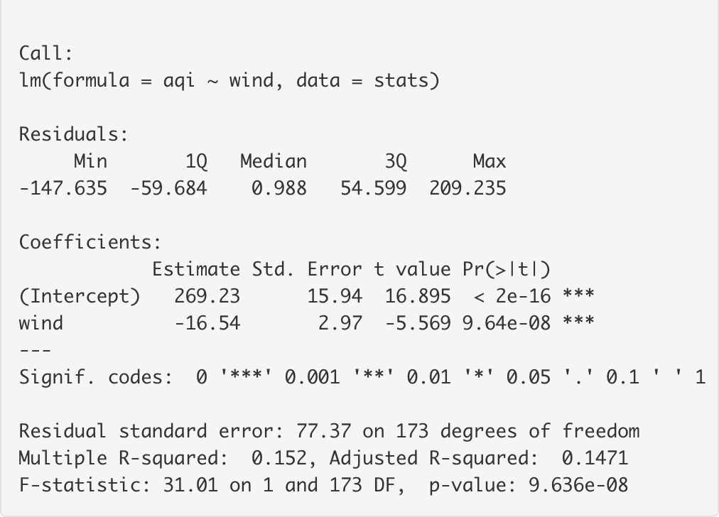
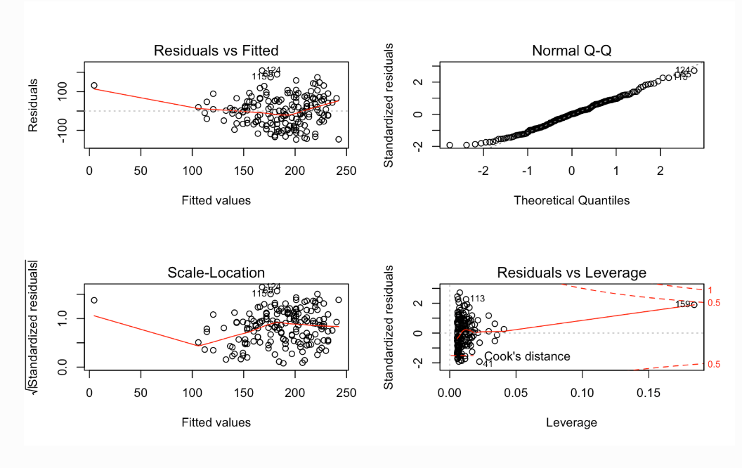
Model building
Since we identified a negative correlation between wind and pollution a simple linear regression model was created with wind as the predictor and AQI as the target variable
Since F=31.01 is far greater than 1. It can be concluded that there is a relationship between predictor and response variable. However with a R2 score of .152 this would not be considered a very predictive model.

Slide 15
Conclusion
My conclusions from the analysis above are that I find all of the claims made by the Delhi Government suspect because :
it does not seem that pollution has really decreased by much between 2015-2019( avg. aqi of 162.44 and 160.07 or -1.46%)
2. any decrease in the pollution can potentially be attributed to a general increase in average wind speed
3. even though the yields of agriculture have gone up the pollution has decreased marginally ( yields of wheat increased by 18 % between 2015 and 2018)
Next steps would be to try and source more accurate data , to do more in-depth modeling and use predictors other than wind.

Slide 16
Thank you

